Slide 1
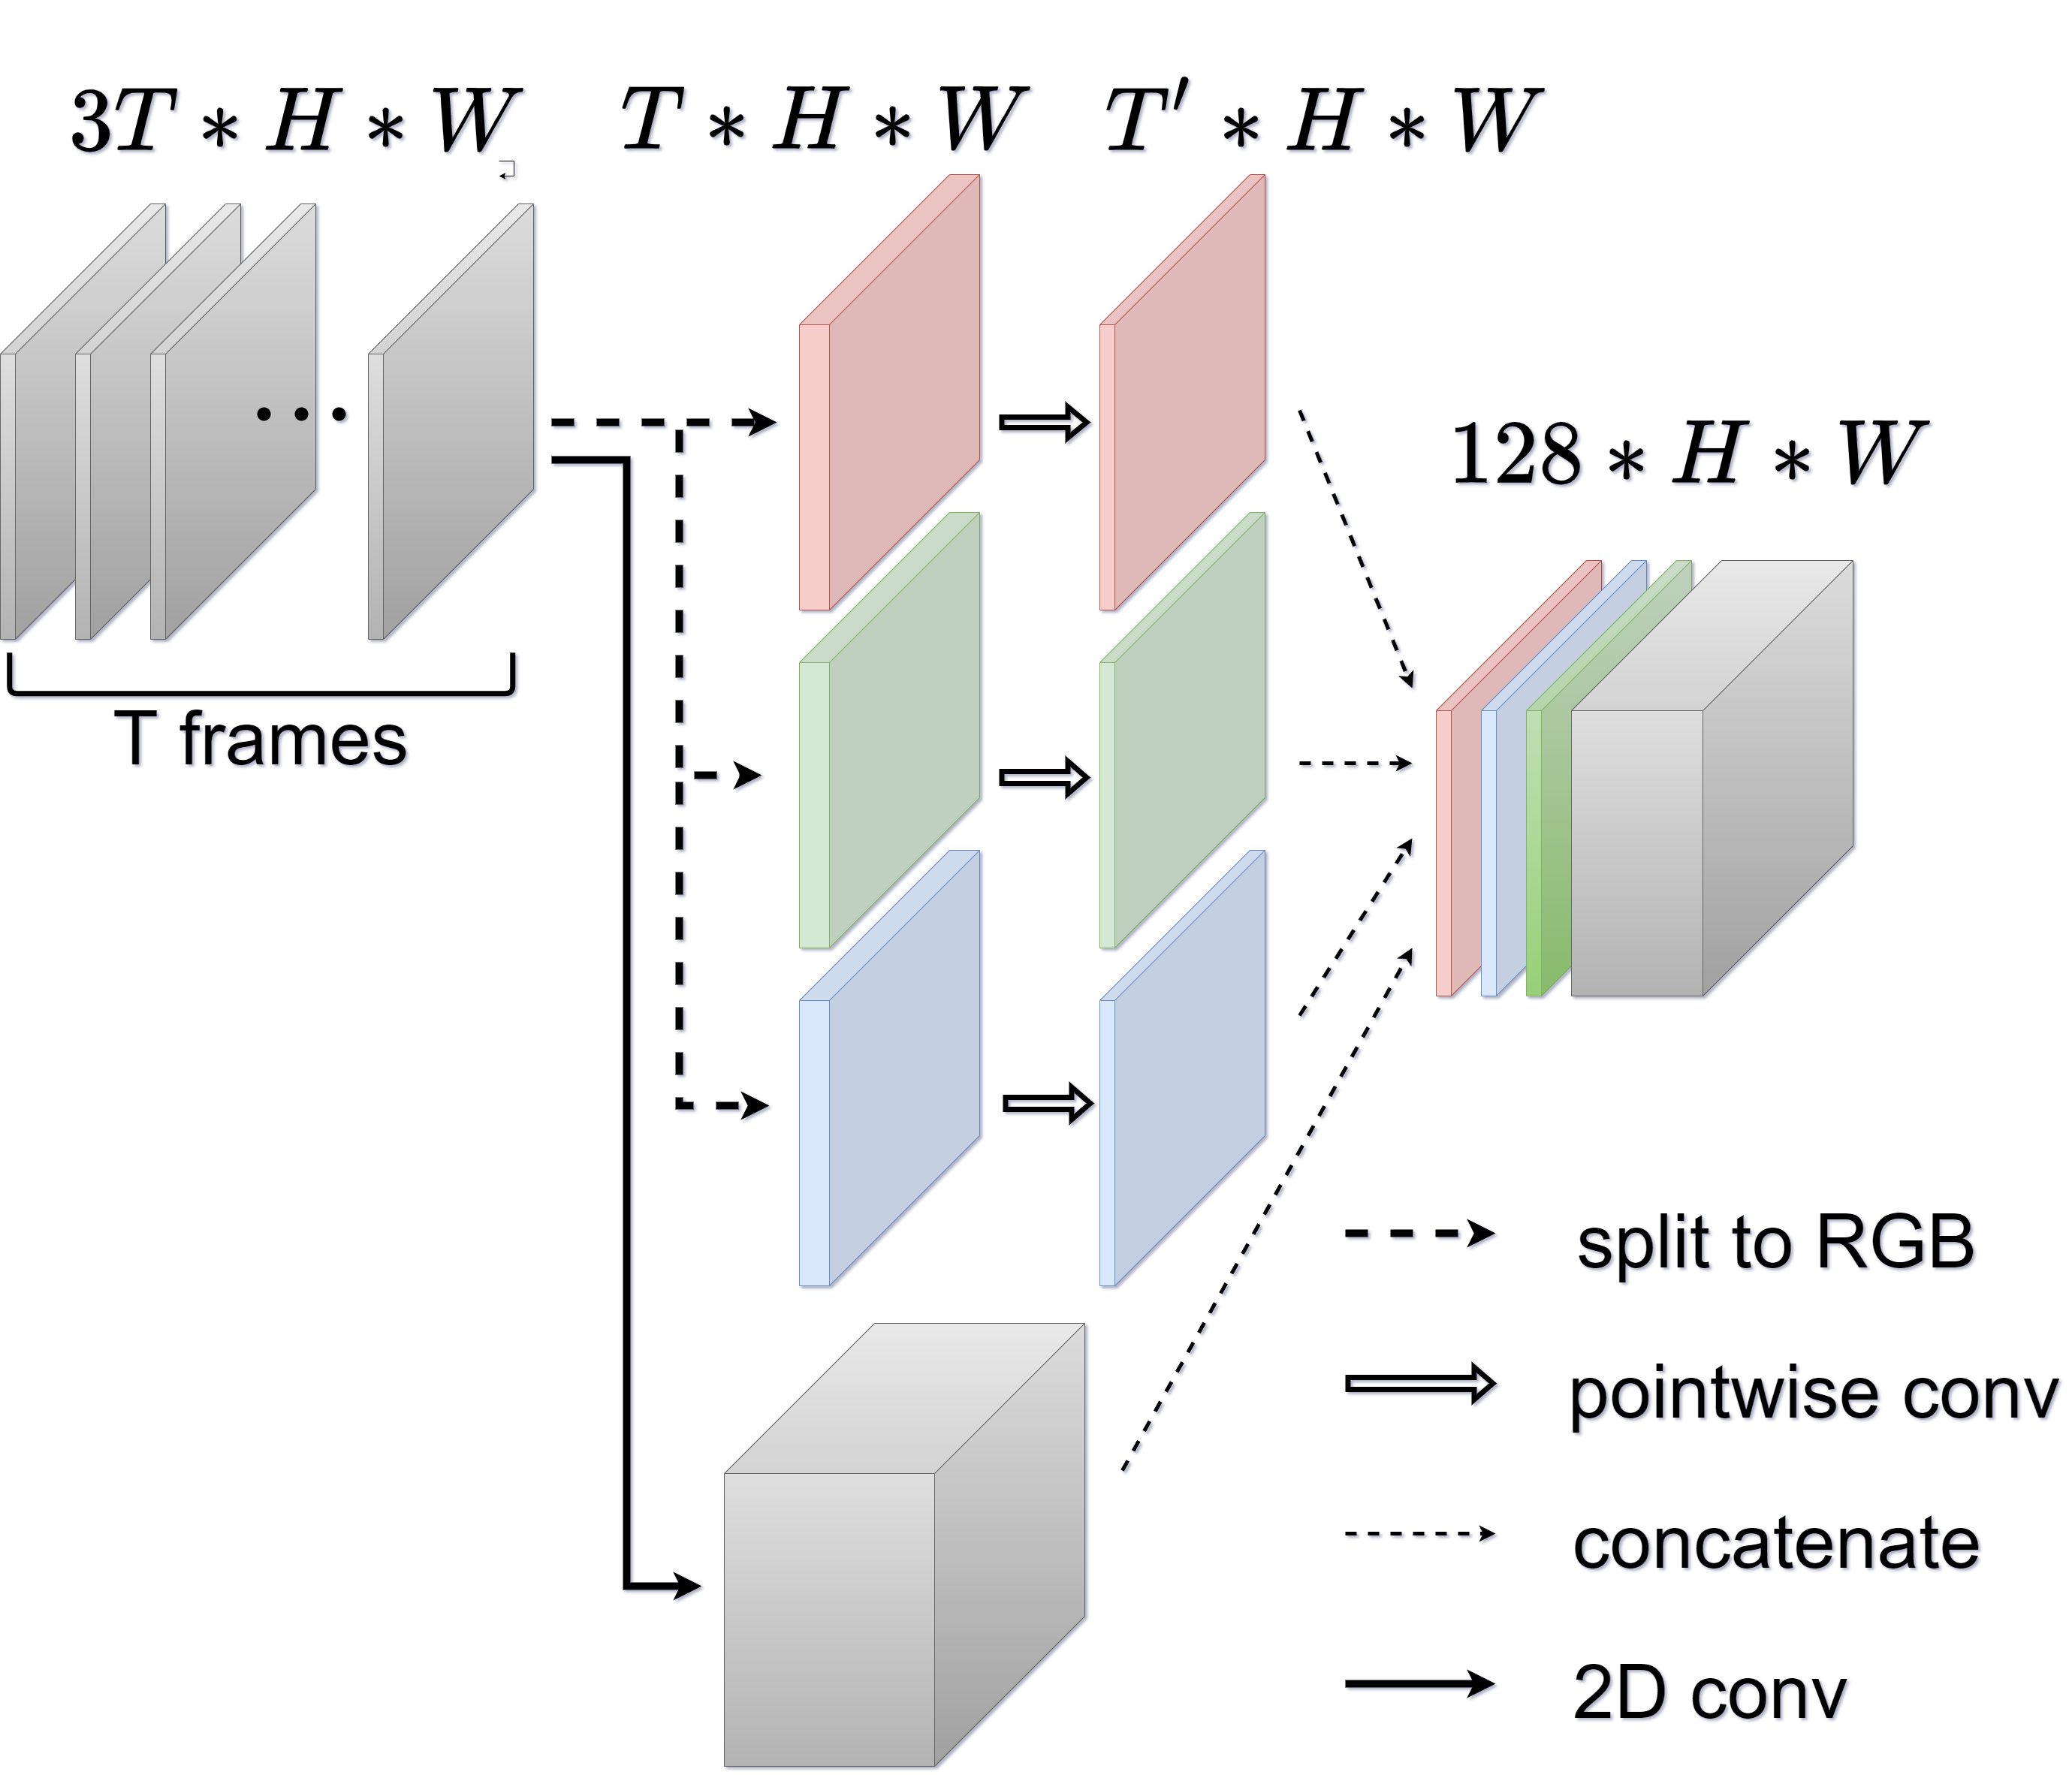
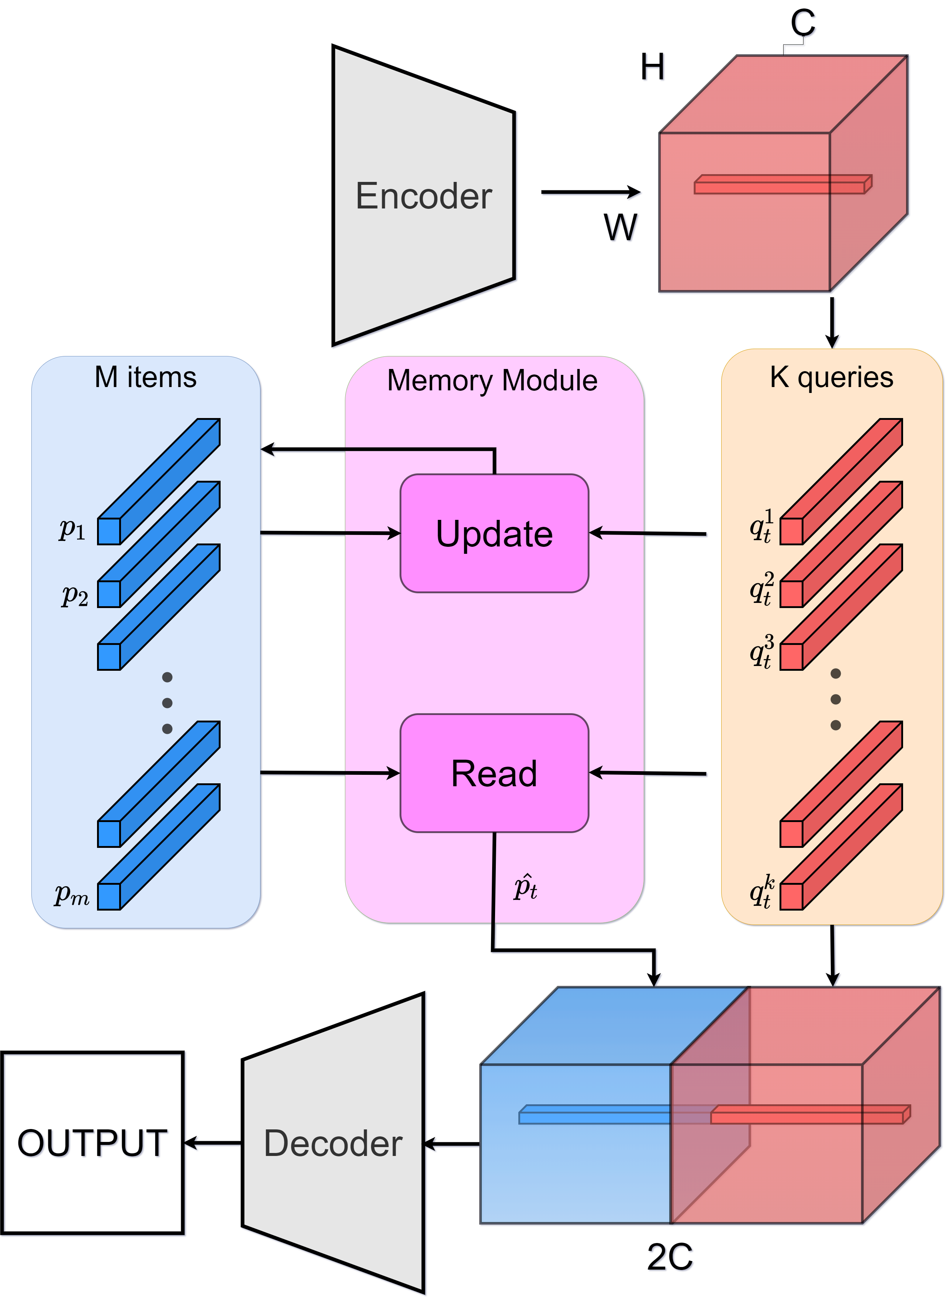
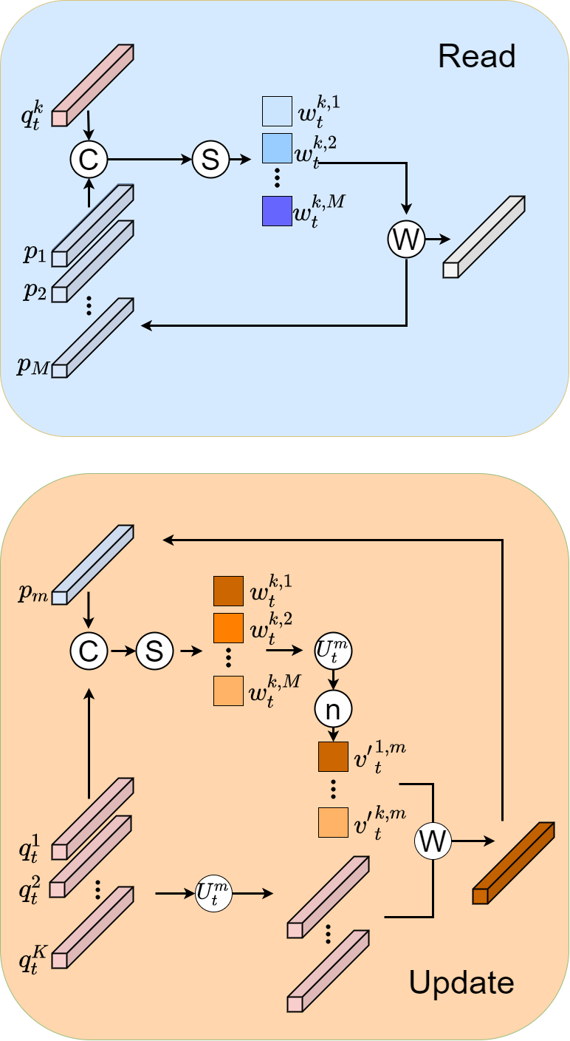
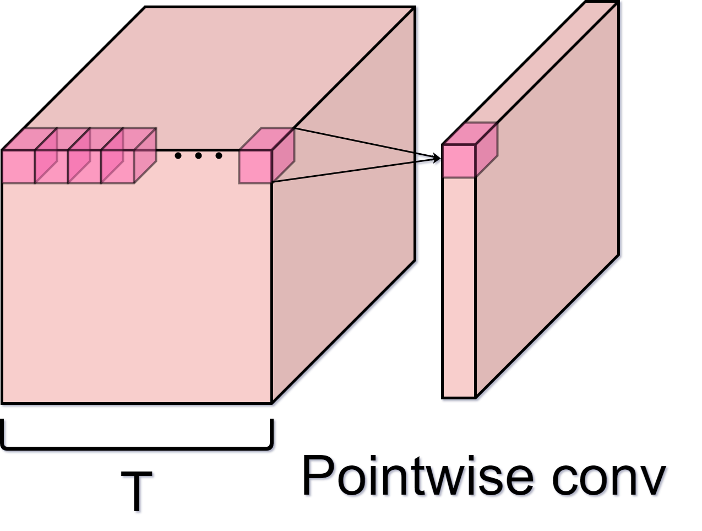
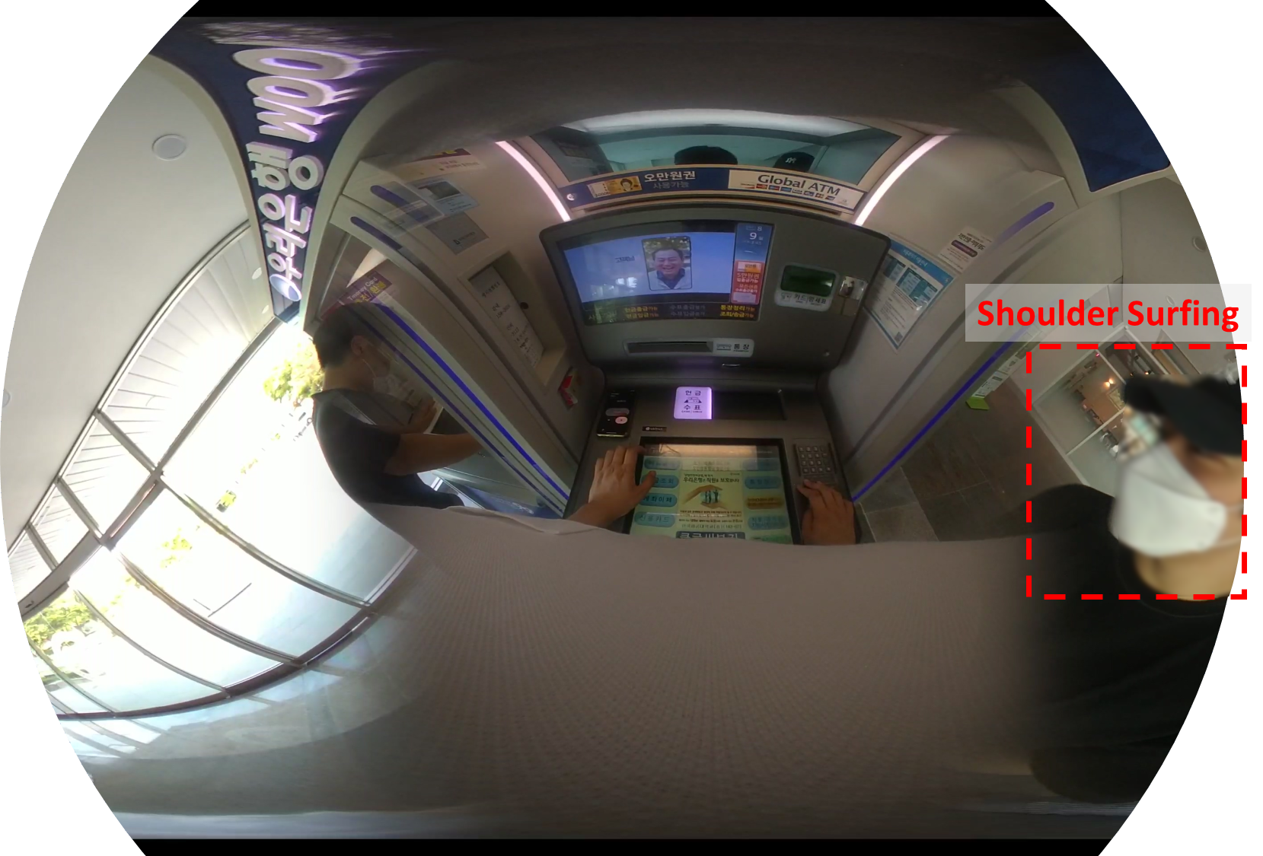
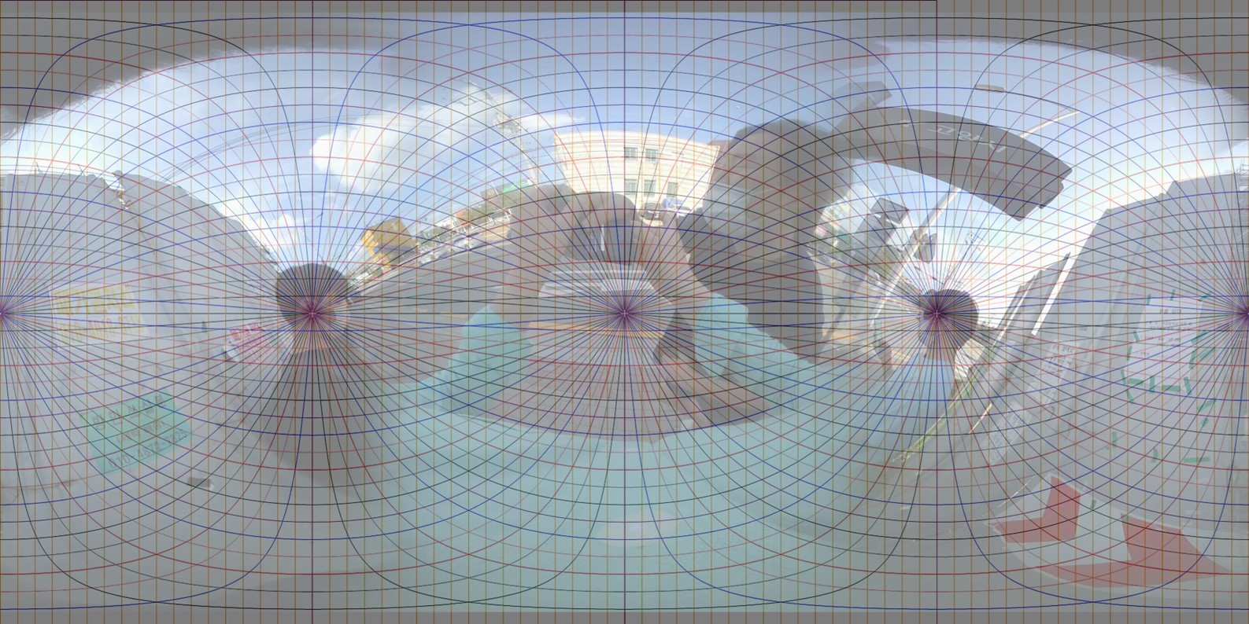
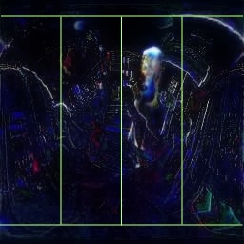
Anomaly Detection for Visually Impaired People Using A 360 Degree Wearable Camera Dongin Kim and Jangwon Lee, School of Electronics and Information Engineering, Korea Aerospace University dongpago@kau.kr, leejang@kau.ac.kr
Introduction
Our objective is to develop an abnormal event detection system for visually impaired people that can detect any suspicious or abnormal activity in their surroundings using a 360-degree wearable camera We have two primary aims: 1) to detect any suspicious or abnormal activity in a 360-degree panorama panoramic image, 2) to identify the direction of the abnormal event
Detecting Anomalous Events
We formulated our two tasks as unsupervised learning problems, so that our model does not require any ground truth labels at a training phase To detect anomalous events, we extend the memory-guided model [2] by adding temporal convolutional kernels to capture temporal information in video <Temporal Convolution Kernels> <Memory-guided Anomaly Detection> [2]
Experiments
Evaluation Metrics: 1) AUC (%) for Anomaly Event Detection 2) Accuracy (%) for Anomalous Event Direction Identification
Method (T = # of input frames) | At Three Different Public Places
 | ATM Booth | Café | Bus Stop
Memory Guided[2] (T=4) | 62.22 (74.46) | 51.89 (91.14) | 80.50 (56.84)
Memory Guided [2](T=8) | 64.49 (73.90) | 49.99 (90.26) | 77.44 (62.14)
Ours (T=8) | 68.47 (76.79) | 63.11 (92.24) | 82.65 (62.98)
The AD-360 Dataset
We collected 132 videos using a 360-degree wearable camera for detecting anomaly activities We annotated a total of 11,037 image frames to have spatio-temporal labels for abnormal events The dataset has two types of labels: (1) direction: the direction of anomaly events (Left-Front, Right-Front, Left-Back, and Right Back), (2) time: when the abnormal events occurred
Conclusion & Future Work
We proposed novel abnormal event detection tasks with a new dataset for visually impaired people using a 360-degree wearable camera for the first time We plan to extend our AD-360 dataset and approach to have more diverse scenarios with more robust model Acknowledgement: This work was supported by the National Research Foundation of Korea(NRF) grant funded by the Korea government (MSIT) (No. 2021R1G1A1010720)
Identifying The Direction of Anomalous Events
To identify the directions of anomalous events, we measure structural similarity between the input video frame and the reconstructed frame by prediction using SSIM
Observing Surroundings
Fitt360: 360° Neckband Camera [1]
Reference
[1] FITT360. https://www.ftt360.us/ (online) [2] Park, Hyunjong, Jongyoun Noh, and Bumsub Ham. “Learning memory-guided normality for anomaly detection,” CVPR 2020

